Slide 1
Introduction to GitHub
Credit: education/Series-Intro-to-GitHub-Flow

Slide 2
What is Git?
Git is a popular version control system.
It was created by Linus Torvalds in 2005, and has been maintained by Junio Hamano since then.
It is used for:
Tracking code changes
Tracking who made changes
Coding collaboration

Slide 3
What does Git do?
Manage projects with Repositories
Clone a project to work on a local copy
Control and track changes with Staging and Committing
Branch and Merge to allow for work on different parts and versions of a project
Pull the latest version of the project to a local copy
Push local updates to the main project

Slide 4
Why Git?
Over 70% of developers use Git!
Developers can work together from anywhere in the world.
Developers can see the full history of the project.
Developers can revert to earlier versions of a project.

Slide 5
What is GitHub?
Git is not the same as GitHub.
GitHub makes tools that use Git.
Cannot use Github without Git, but can use Git without Github
GitHub is the largest host of source code in the world, and has been owned by Microsoft since 2018.

Slide 6
Why Github?
Promotes collaboration among developers
Acts as a community platform where developers can learn from each other.
This open environment facilitates the sharing of knowledge and expertise.
GitHub repository can act as a portfolio, demonstrating skills and experience to potential employers

Slide 7
Importance of Github in AI
It hosts numerous open-source AI projects
Enable collaboration across the globe
Many leading AI frameworks and libraries (like TensorFlow, PyTorch, and scikit-learn) are available on GitHub.
Allows researchers to share their models along with datasets and experiment setups, making it easier for others to reproduce and verify their findings.

Slide 8
GitHub essentials
Repositories
Branches
Commits
Pull requests

Slide 9
Repository
A repository is where your project work happens--think of it as your project folder.
It contains all of your project’s files and revision history.
Repositories can contain
folders and files,
images,
videos,
spreadsheets,
and data sets
-- anything your project needs.

Slide 10
Working with Git
Initialize Git on a folder, making it a Repository
Git now creates a hidden folder to keep track of changes in that folder
When a file is changed, added or deleted, it is considered modified
You select the modified files you want to Stage
The Staged files are Committed, which prompts Git to store a permanent snapshot of the files
Git allows you to see the full history of every commit.
You can revert back to any previous commit.
Git does not store a separate copy of every file in every commit, but keeps track of changes made in each commit!

Slide 11
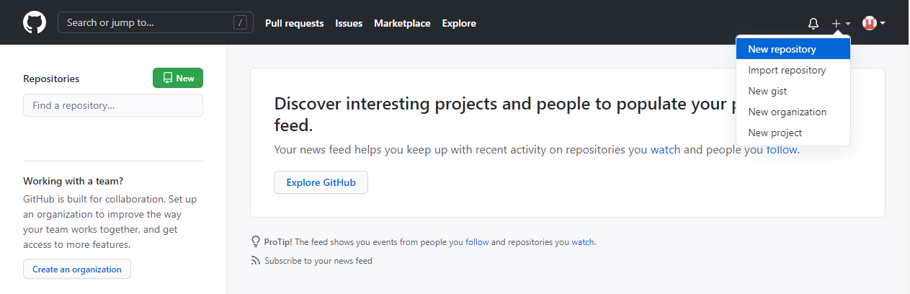
Create a Repo on Github

Slide 12
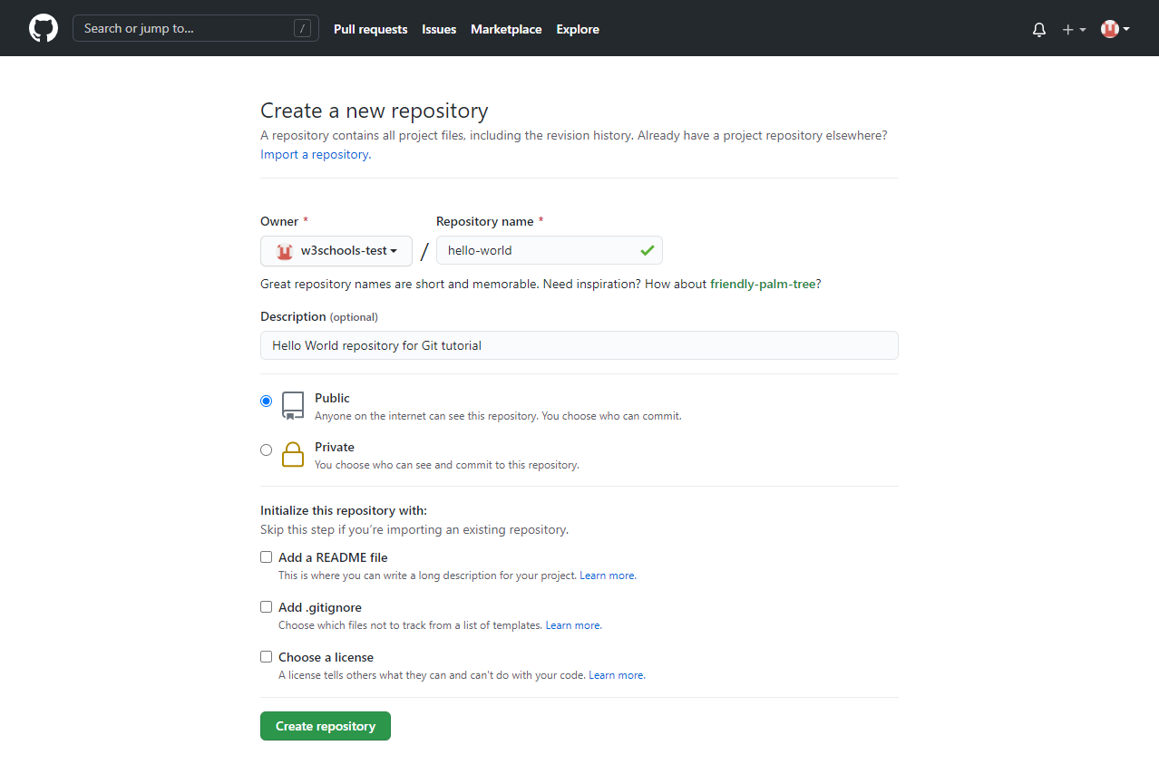
Create a Repo on Github
In the "Repository name" box, type hello-world.
In the "Description" box, type a short description.
Select whether your repository will be Public or Private.
Select Add a README file.
Click Create repository.

Slide 13
GitHub Flow
Create a new Branch
Make changes and add Commits
Open a Pull Request
Review
Merge

Slide 14
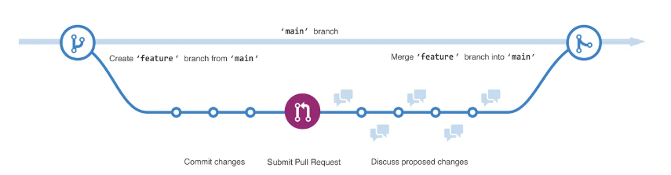
Branches
You can use branches on GitHub to isolate work that you do not want merged into your final project just yet.
By default, your repository has one branch named main.
Creating additional branches allows you to copy the main branch of your repository and safely make any changes without disrupting the main project.
Many people use branches to work on specific features without affecting any other parts of the project.

Slide 15
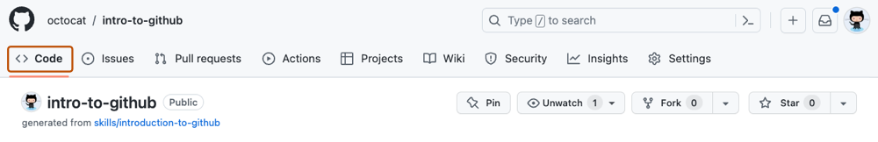
Activity- Your First Branch
Navigate to your newly made repository.
Navigate to the < > Code tab in the header menu of your repository.

Slide 16
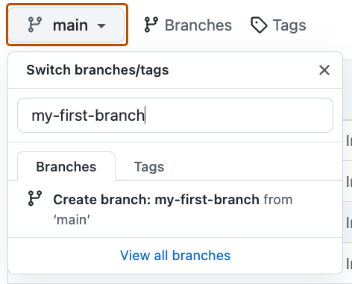
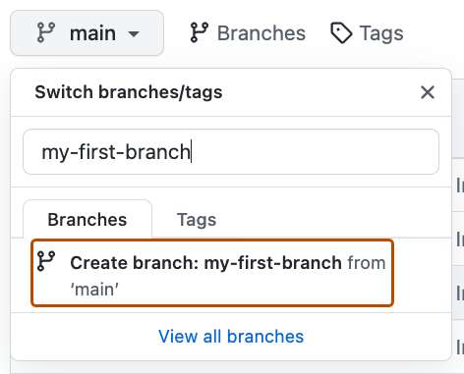
Activity- Your First Branch
Click on the main branch drop-down.
In the field, name your branch "my-first-branch"

Slide 17
Commit
On GitHub, saved changes are called commits.
Each commit has an associated commit message, which is a description explaining why a particular change was made.
Commit messages capture the history of your changes so that other contributors can understand what you’ve done and why.

Slide 18
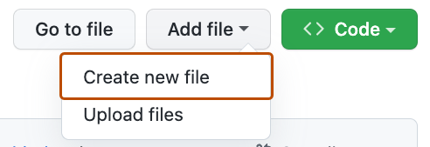
Activity: Your First Commit
A commit records changes in renaming, changing content within, creating a new file, and any other changes made to your project.
For this exercise, committing a change requires first adding a new file to your new branch.
On the < > Code tab in the header menu of your repository, make sure you're on your new branch my-first-branch
Select the Add file drop-down and click Create new file.

Slide 19
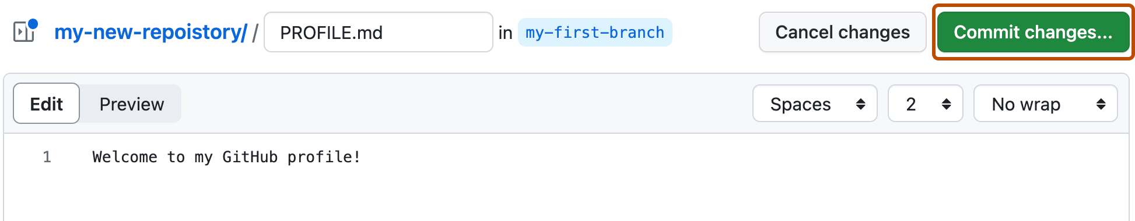
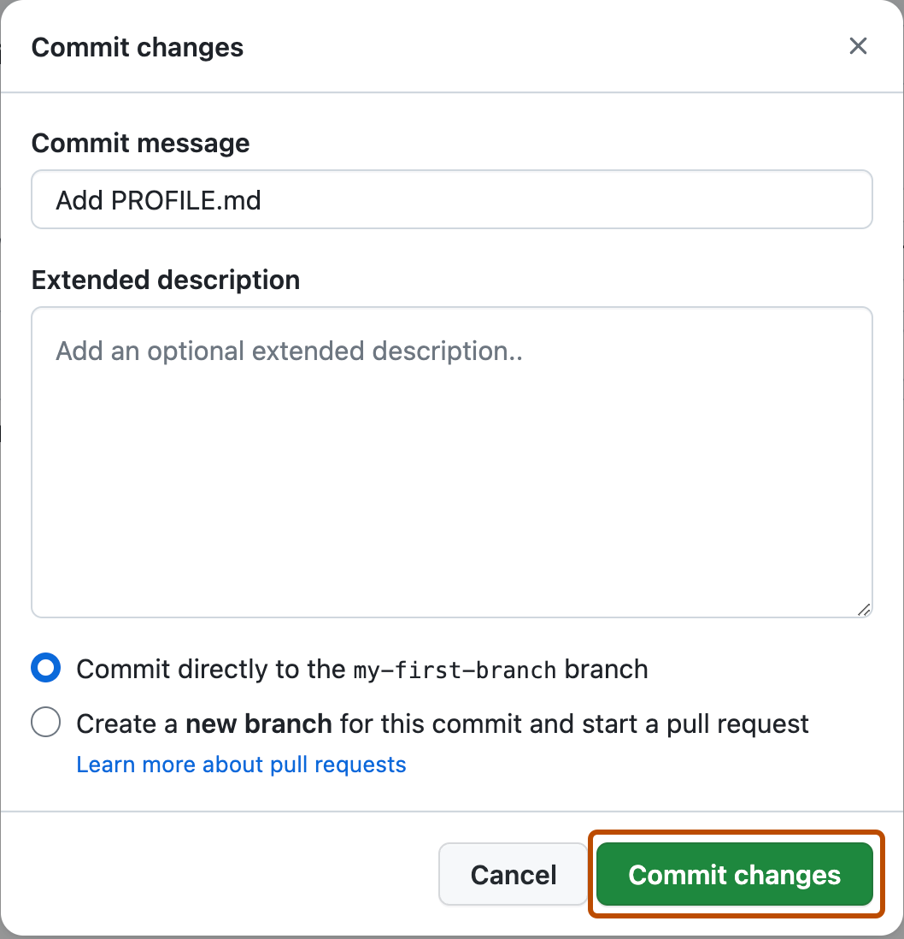
Activity: Your First Commit
In the Name your file... field, enter PROFILE.md. (markdown file)
In the Enter file contents here area, copy the following content to your file.
Click Commit changes... in the upper right corner above the contents box.
For commits, you can enter a short commit message that describes what changes you made.

Slide 20
Pull Request
You have made a change to the project and created a commit, it’s time to share your proposed change through a pull request!
Collaboration happens on a pull request.
The pull request shows the changes in your branch to other people and allows people to accept, reject, or suggest additional changes to your branch.
In a side by side comparison, this pull request is going to keep the changes you just made on your branch and propose applying them to the main project branch.
The changes, additions, and subtractions are shown in different colors.
By using GitHub's @mention feature in your pull request message, you can ask for feedback from specific people or teams.

Slide 21
Activity: Create a pull request
Click on the Pull requests tab in the header menu of your repository.
Click New pull request.
In the base: dropdown, make sure main is selected.
Select the compare: dropdown and click my-first-branch.
Click Create pull request.

Slide 22
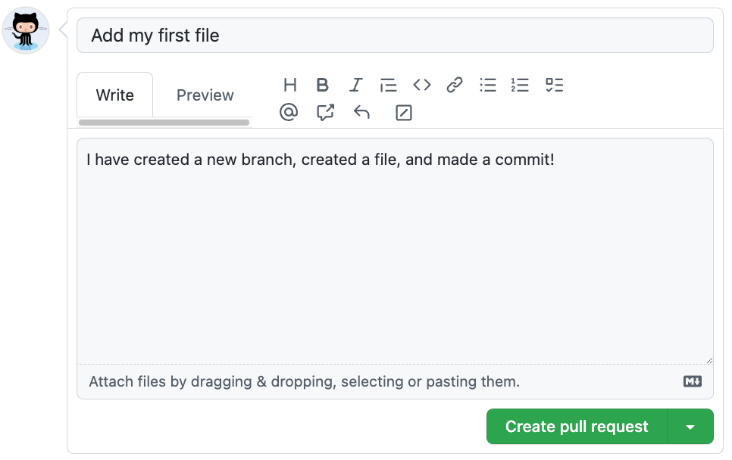
Activity: Create a pull request
Enter a title for your pull request. By default, the title will automatically be the name of your branch. For this exercise, let's edit the field to say Add my first file.
The next field helps you provide a description of the changes you made.
Click Create pull request. You will automatically be navigated to your new pull request.

Slide 23
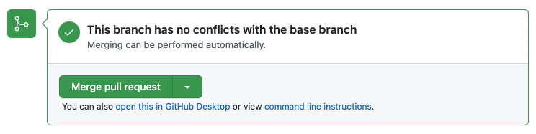
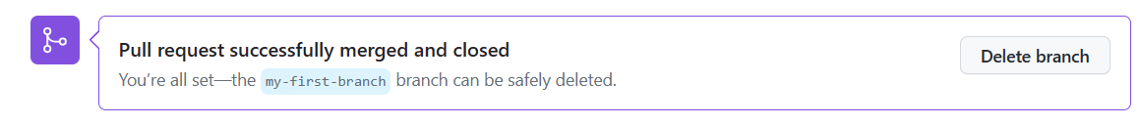
Activity: Merge your pull request
A merge adds the changes in your pull request and branch into the main branch.
Click Merge pull request.
Click Confirm merge.
Once your branch has been merged, you don't need it anymore. To delete this branch, click Delete branch.

Slide 24
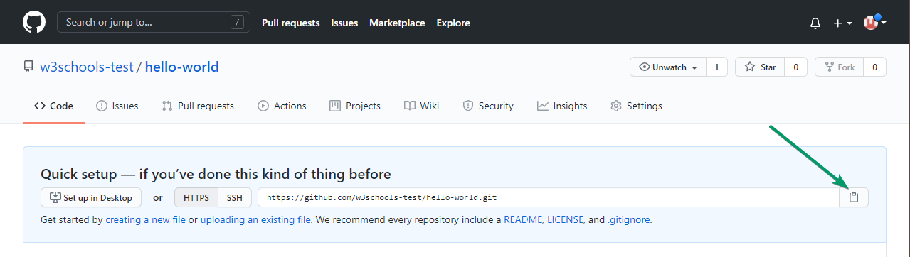
Push Local Repository to GitHub
Copy the URL, or click the clipboard marked in the image

Slide 25
Forks
A fork is another way to copy a repository, but is usually used when you want to contribute to someone else’s project.
Forking a repository allows you to freely experiment with changes without affecting the original project and is very popular when contributing to open source software projects!

Slide 26
Push Local Repository to GitHub
Paste it the following command:
git remote add origin https://github.com/w3schools-test/hello-world.git
git remote add origin URL specifies that you are adding a remote repository, with the specified URL, as an origin to your local Git repo.

Slide 27
Push Local Repository to GitHub
we are going to push our master branch to the origin url, and set it as the default remote branch:
git push --set-upstream origin master
Enumerating objects: 22, done.
Counting objects: 100% (22/22), done.
Delta compression using up to 16 threads
Compressing objects: 100% (22/22), done.
Writing objects: 100% (22/22), 92.96 KiB | 23.24 MiB/s, done.
Total 22 (delta 11), reused 0 (delta 0), pack-reused 0
remote: Resolving deltas: 100% (11/11), done.
To https://github.com/w3schools-test/hello-world.git
* [new branch] master -> master
Branch 'master' set up to track remote branch 'master' from 'origin'.

Slide 28
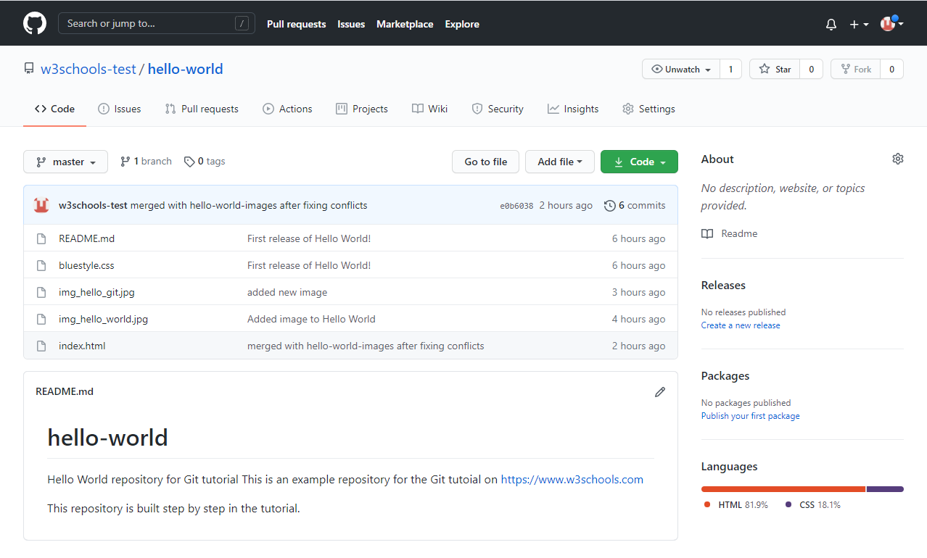
Repository Updated

Slide 29
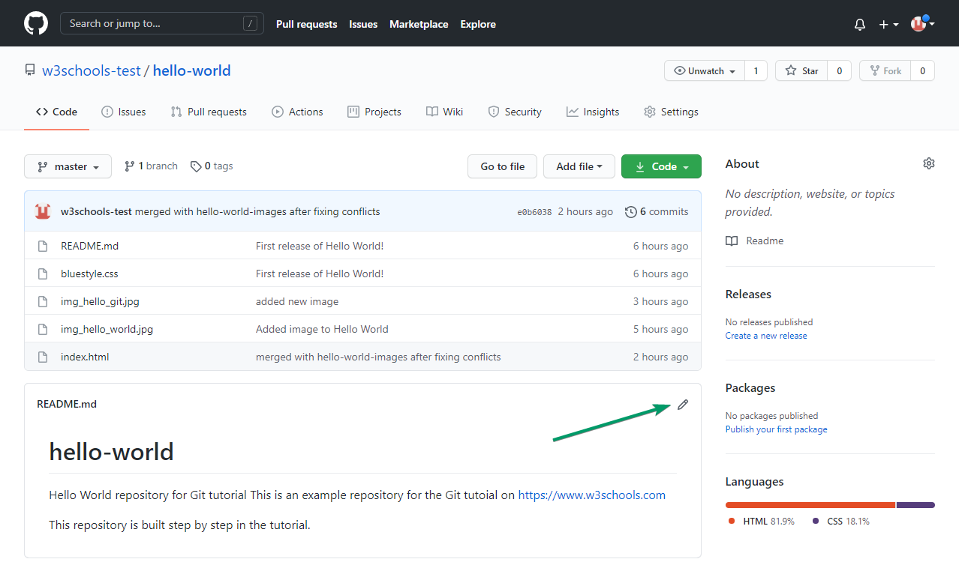
Edit Code in Github
Edit the README.md file in GitHub.
Just click the edit button

Slide 30
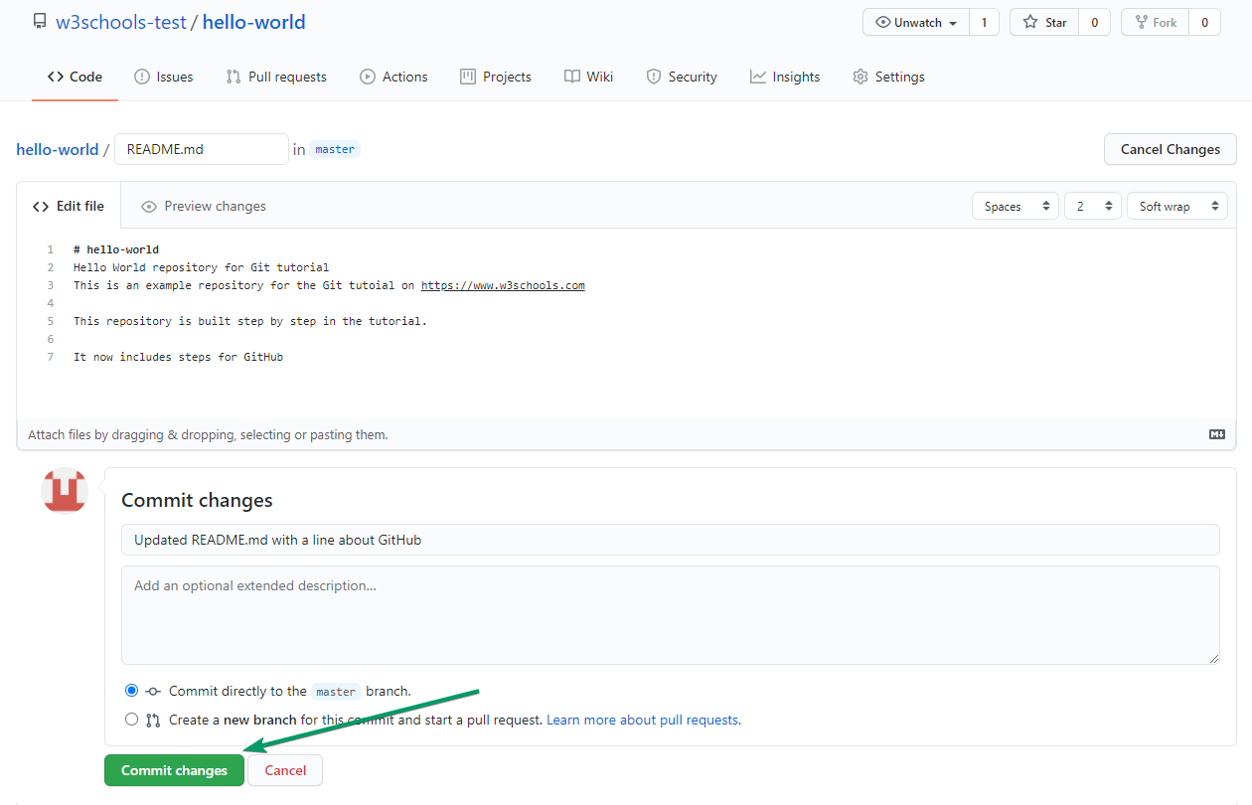
Edit Code in Github
Add some changes to the code
and then commit the changes.
For now, we will "Commit directly to the master branch".
Remember to add a description for the commit

Slide 31
Link to Course GitHub
IAT-ExploringAI-2024 (github.com)

